Slide 1
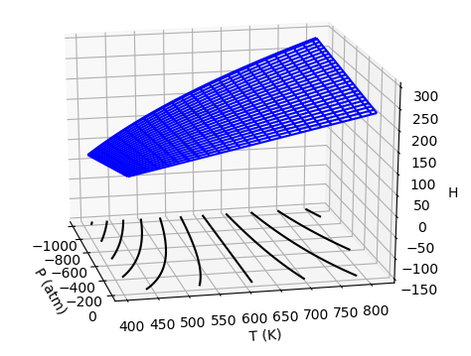
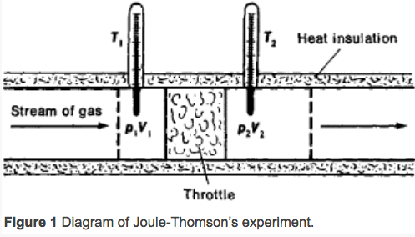

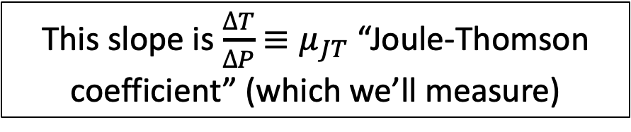
Experiment: The Adiabatic Joule-Thomson experiment
A key feature of the Adiabatic Joule-Thomson experiment is that the gas follows an isenthalp (line of constant enthalpy) on its way out of the tank.
We’ll measure how much the temperature goes up or down, hence $\frac{∆T}{∆P}$.
https://encyclopedia2.thefreedictionary.com/Joule-Thomson+Effect
This slope is $\frac{∆T}{∆P}$ ${≡μ}_{JT}$ “Joule-Thomson coefficient” (which we’ll measure)

Slide 2

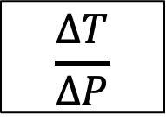


We still have to get from $\frac{∆T}{∆P}$ to $μ_{T}$
$$C_{P}$$
First, we note that
$$μ_{JT}≈{\left(\frac{∂T}{∂P}\right)}_{H}$$
$$μ_{T}$$
$$\frac{∆T}{∆P}$$

Slide 3
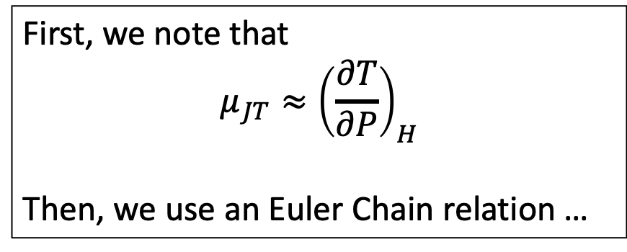
We still have to get from $\frac{∆T}{∆P}$ to $μ_{T}$
$$C_{P}$$
First, we note that
$$μ_{JT}≈{\left(\frac{∂T}{∂P}\right)}_{H}$$
Then, we use an Euler Chain relation …
$$μ_{T}$$
$$\frac{∆T}{∆P}$$

Slide 4
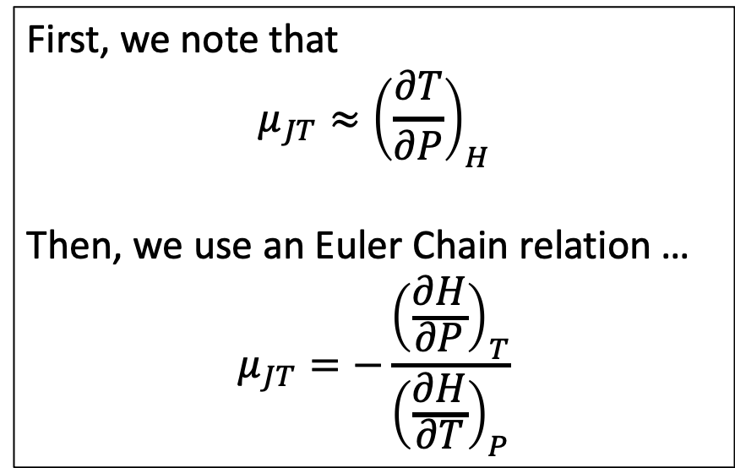
We still have to get from $\frac{∆T}{∆P}$ to $μ_{T}$
$$C_{P}$$
First, we note that
$$μ_{JT}≈{\left(\frac{∂T}{∂P}\right)}_{H}$$
Then, we use an Euler Chain relation …
$$μ_{JT}=−\frac{{\left(\frac{∂H}{∂P}\right)}_{T}}{{\left(\frac{∂H}{∂T}\right)}_{P}}$$
$$μ_{T}$$
$$\frac{∆T}{∆P}$$

Slide 5
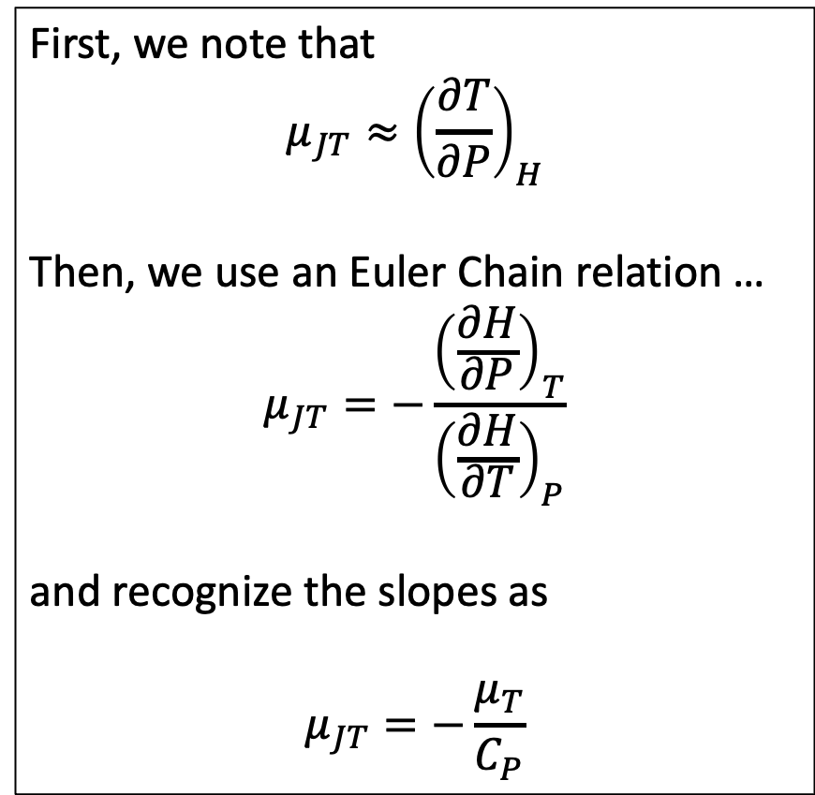
We still have to get from $\frac{∆T}{∆P}$ to $μ_{T}$
$$C_{P}$$
First, we note that
$$μ_{JT}≈{\left(\frac{∂T}{∂P}\right)}_{H}$$
Then, we use an Euler Chain relation …
$$μ_{JT}=−\frac{{\left(\frac{∂H}{∂P}\right)}_{T}}{{\left(\frac{∂H}{∂T}\right)}_{P}}$$
and recognize the slopes as
$$μ_{JT}=−\frac{μ_{T}}{C_{P}}$$
$$μ_{T}$$
$$\frac{∆T}{∆P}$$

Slide 6


We still have to get from $\frac{∆T}{∆P}$ to $μ_{T}$
$$C_{P}$$
First, we note that
$$μ_{JT}≈{\left(\frac{∂T}{∂P}\right)}_{H}$$
Then, we use an Euler Chain relation …
$$μ_{JT}=−\frac{{\left(\frac{∂H}{∂P}\right)}_{T}}{{\left(\frac{∂H}{∂T}\right)}_{P}}$$
and recognize the slopes as
$$μ_{JT}=−\frac{μ_{T}}{C_{P}}$$
$$μ_{T}$$
$$\frac{∆T}{∆P}$$
And solve for $μ_{T}$
$$μ_{T}=−{μ_{JT}C}_{P}$$

